Slide 1
Welcome to
Air Force Financial Readiness
First Duty Station – Officers Course
Personal Financial Readiness

Slide 2

Housekeeping
Breaks
Classroom logistics
Cell phones
Respect contributions of others
Sidebar conversations

Slide 3

Agenda
Introduction
Military Money
Manage Your Money
Smart Spending
Conclusion

Slide 4

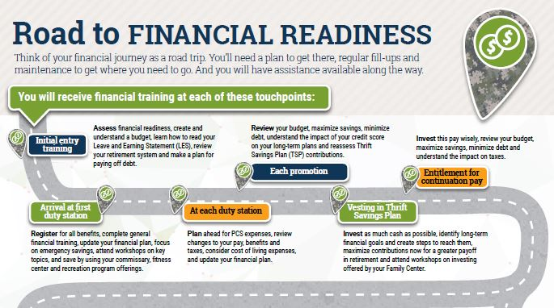
Financial Readiness Touchpoints
4

Slide 5
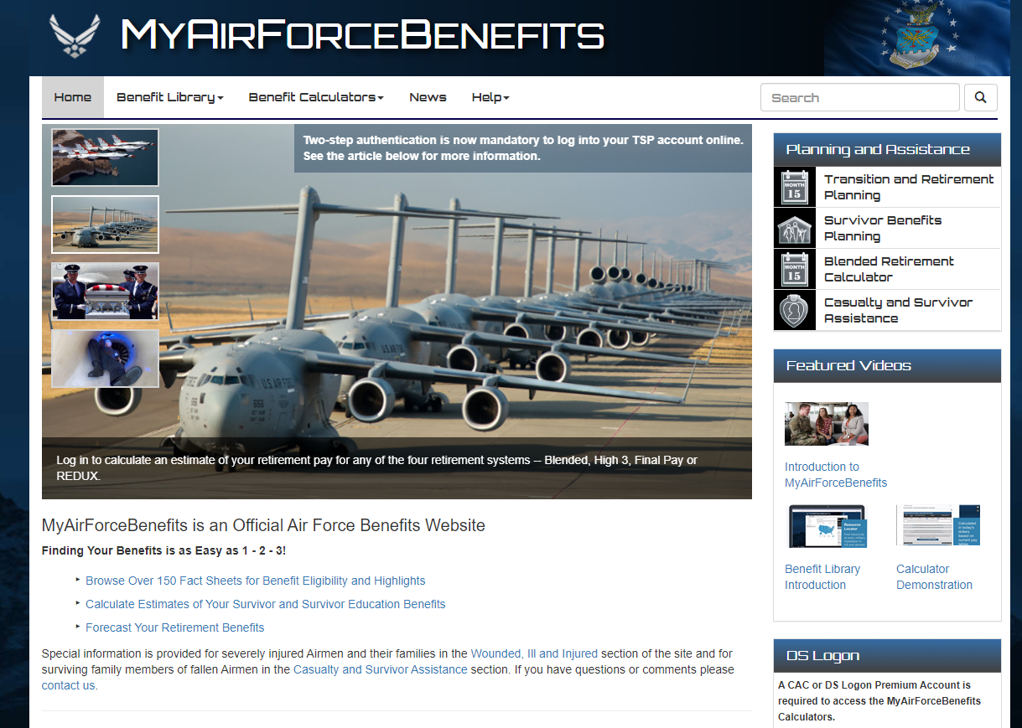
My Air Force Benefits
https://myairforcebenefits.altess.army.mil/

Slide 6
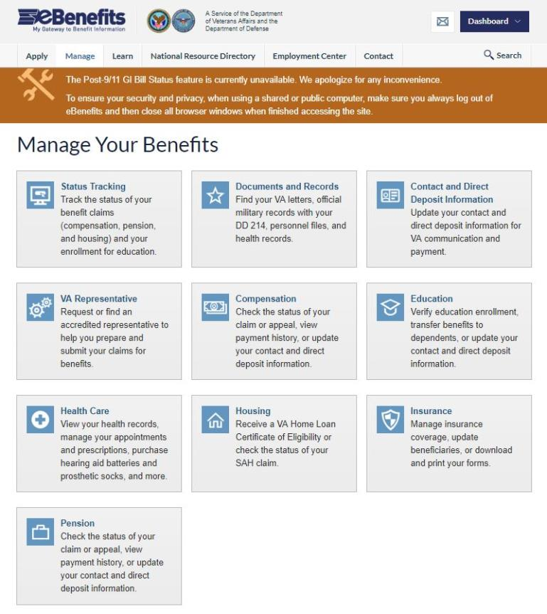
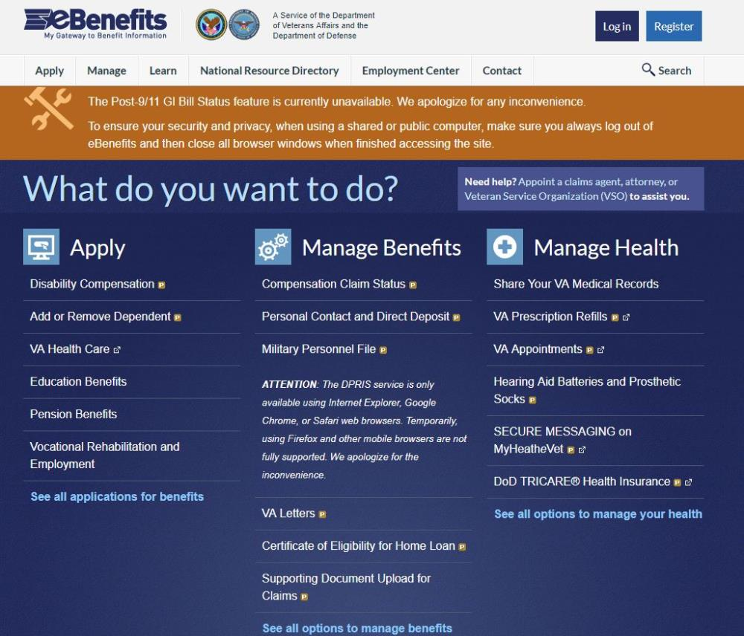
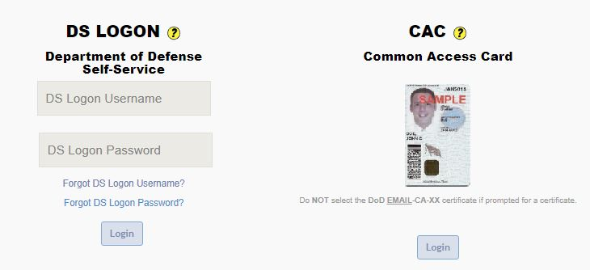
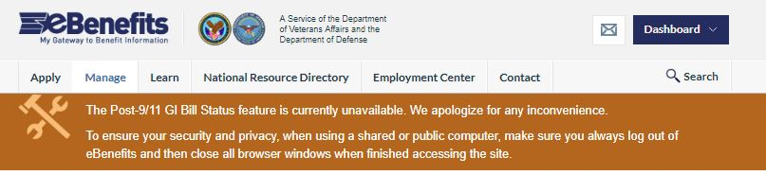
eBenefits

Slide 7

Air Force Priorities
Restore readiness…
  to win any fight, any time.
Cost-effectively modernize…
  to increase the lethality of the force.
Drive innovation…
  to secure our future.
Develop exceptional leaders…
  to lead the world’s most powerful teams.
Strengthen our alliances…
  because we are stronger together.

Slide 8
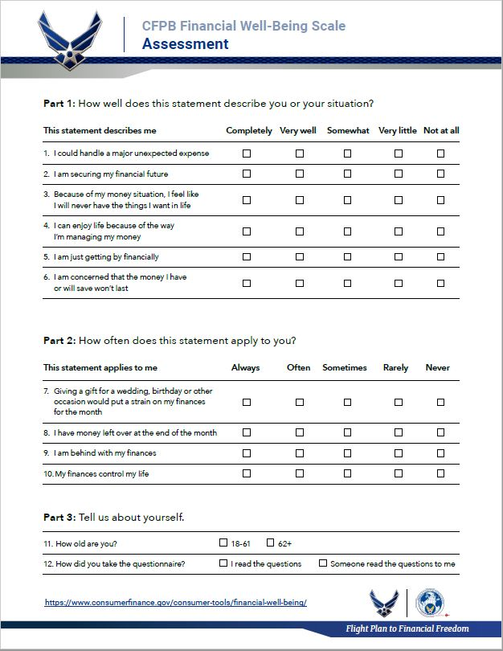

Financial Well-Being Assessment

Slide 9


TOPIC ONE:
MILITARY MONEY

Slide 10

Agenda
Understanding Military Pay

Slide 11
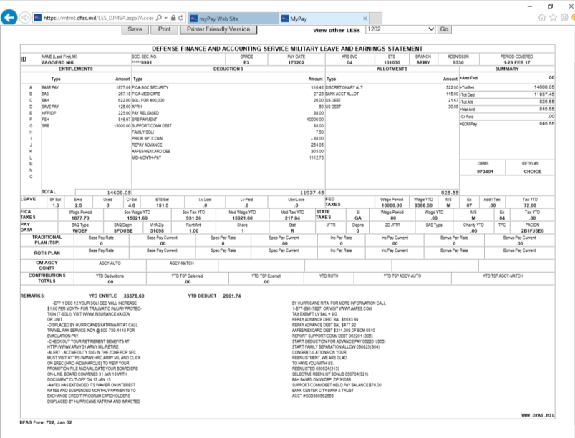

LES Beat the Bell

Slide 12



Allotments
Discretionary
Non-discretionary
Individual, institution, business
Maximum of six
Designated agency or purpose
No limit

Slide 13

Common Pay Problems
Overpayments and underpayments.
Unexpected repayments.
Permanent change of station (PCS) and deployment pay issues.
Changes in dependent status.
Starting and stopping allotments.
Too many allotments.

Slide 14


The Rockefeller File

Slide 15

Finally, remember . . .
Your pay is your responsibility.
Verify that every LES is correct.
Correct discrepancies immediately.

Slide 16

TOPIC TWO
MANAGE YOUR MONEY

Slide 17

Agenda
Develop a spending plan.
Choose a bank or credit union.
Set saving and investing goals.

Slide 18
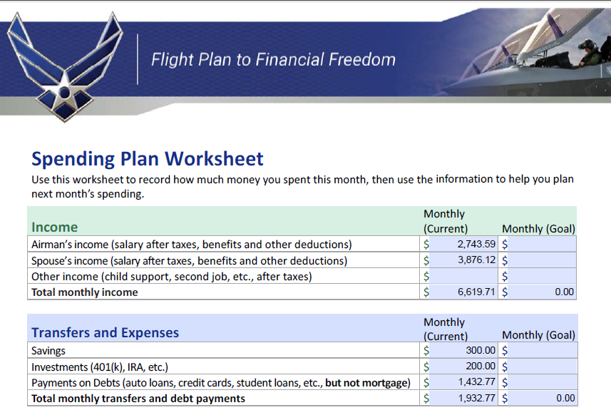
Spending Plan Worksheet

Slide 19
Income Reductions

Slide 20

Living Expenses
Housing
Food
Transportation
Health
Personal and Family
Other
Uncategorized

Slide 21
DTIR: How Much is Too Much?
Without Mortgage | With Mortgage
<15%: Well-positioned | <36%: Well-positioned
16%-20%: Fully extended | 37%-42%: Fully extended
21%-30%: Overextended | 43%-49% Overextended
>30%: Seek help | >50%: Seek help

Slide 22
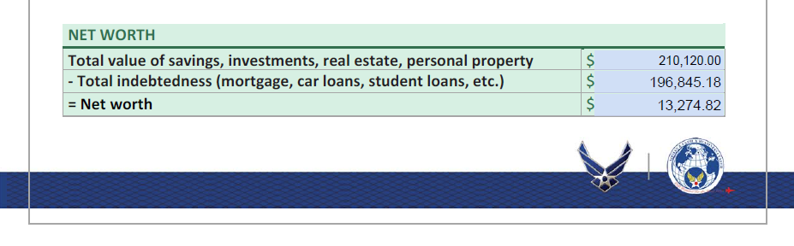
Net Worth
What you own
– What you owe
= Net worth
210,120.00
196,845.18
13,274.82
v

Slide 23

Unique Budget Challenges
Deployment
TDY
PCS

Slide 24
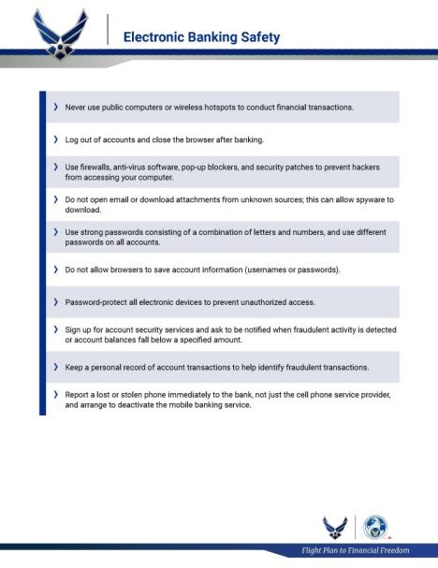
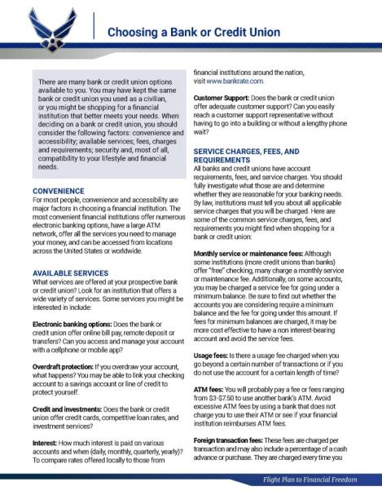

Personal Banking
A personal decision based on personal needs and preferences.
Be aware of services and costs.
Be sure to keep account information secure.

Slide 25

Introduction to Saving and Investing
Remember: The best way to achieve long-term financial goals is to invest as well as save, and to start investment contributions as soon as possible!

Slide 26
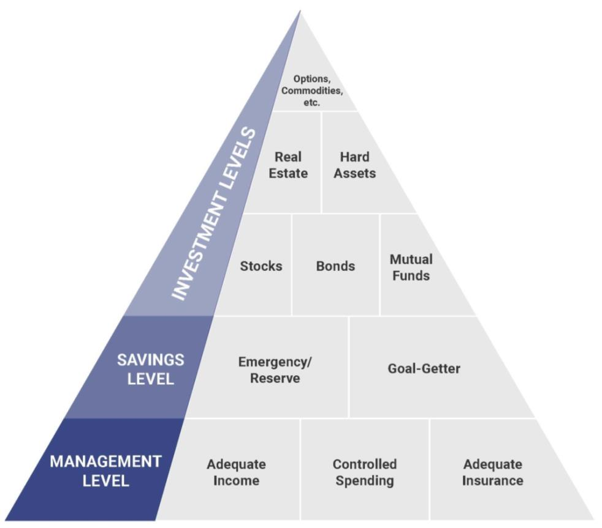
Saving

Slide 27

Saving Strategies
Emergency/reserve funds
“Goal-getter” fund(s)
Investments

Slide 28
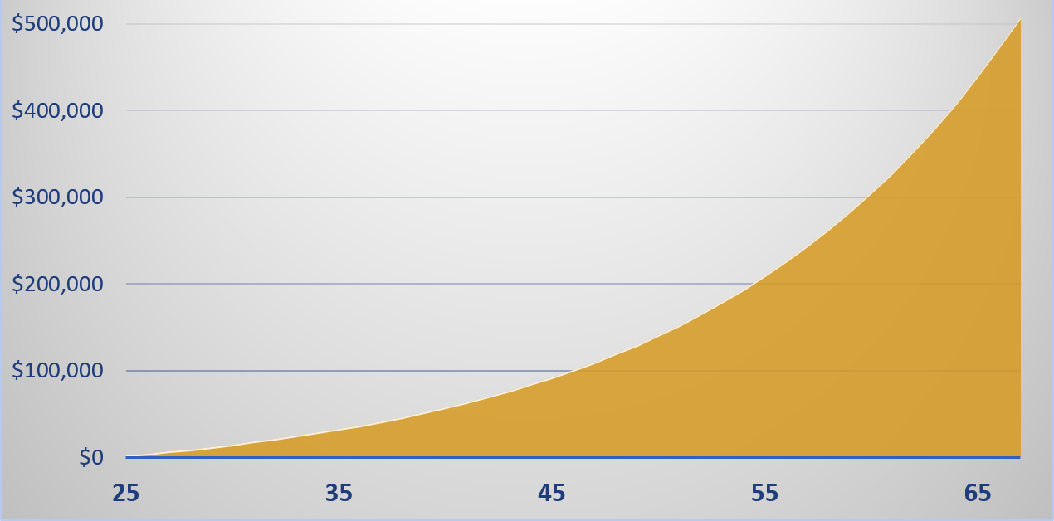
Time and Compounding

Slide 29
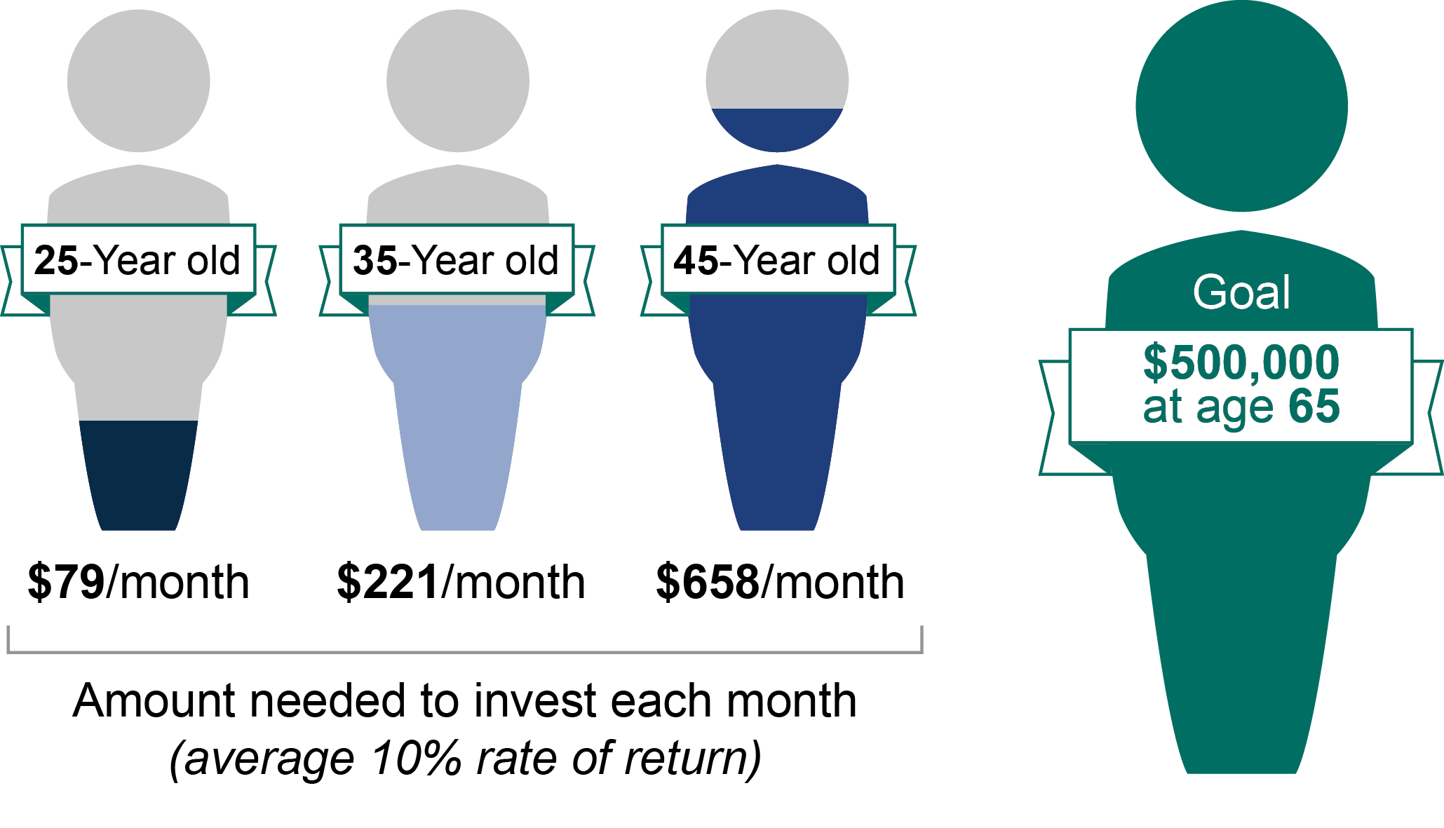
Starting Early
25-Year-old
35-Year-old
45-Year-old
$500,000
at age 67
$153/month $324/month $735/month
Amount needed to invest each month
(average 7% rate of return)

Slide 30


Investment Options
Personal investment accounts
401(k) accounts
Individual retirement accounts (IRA)
Other types of investment accounts

Slide 31



Investment Instruments
Stocks
Bonds
Mutual Funds

Slide 32

Introduction to BRS
In effect January 1, 2018.
20-year retired pay.
TSP contributions (similar to 401(k) account).

Slide 33
Matching Funds
1% DoD contribution
+ 5% Airman contribution
+ 4% DoD match
10% annually

Slide 34
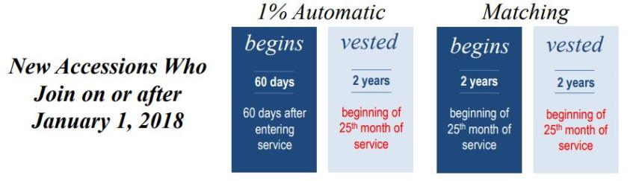
Vesting

Slide 35
Thrift Savings Plan
Your retirement savings and investing plan.
Contributions invested in mutual funds.
Goal: Invest at least as much as DoD will match.

Slide 36

Section Subtotal: Manage Your Money
Manage spending.
Choose the financial services you need.
Start saving and investing early.
Get the best interest you can on savings.
Let compounding of interest and earnings work for you.
Contribute at least as much base pay to TSP as the DoD will match.

Slide 37

TOPIC THREE:
SMART SPENDING

Slide 38

Agenda
Credit and debt management
Financial consumer awareness
Car-buying strategies
Home-buying strategies
Insurance

Slide 39

Credit and Debt Management

Slide 40

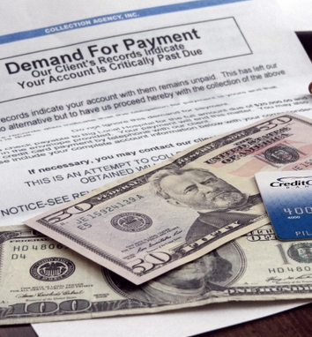
The Impact of Credit

Slide 41



Credit Reports
www.annualcreditreport.com or your A&FRC

Slide 42

Credit Report Components
Identification and employment
Payment history
Inquires
Public record information
Accurate information

Slide 43

Credit Scores
750 and higher: Excellent
700–749: Very good
650–699: Good
600–649: Fair
599 and below: Poor

Slide 44

Choosing and Using Credit Cards

Slide 45

Cutting Credit Card Costs

Slide 46

Government Travel Charge Cards (GTCC)
Necessary for temporary
duty assignment (TDY) and
other travel.
Airmen must apply for GTCC.
Type of card issued reflects
credit rating.
GTCC is for official travel ONLY.
Discipline will follow misuse or mismanagement of account.

Slide 47

Managing Debt
Too much of a good thing is not a good thing.

Slide 48

Warning Signs of Credit Trouble

Slide 49
Recovering from Excessive Debt
Take charge
Prioritize debts
Power pay
Talk with creditors
Get legal counsel
Change behavior

Slide 50

Student Loan Debt

Slide 51

Subtotal: Credit and Debt Management
Have a working spending plan.
Calculate debt-to-income ratio.
  - Goal <20% of net income.
Plan for credit purchases.
Shop for credit.
Check credit report annually.
Manage debt: reduce or eliminate.

Slide 52




Financial Consumer
Awareness

Slide 53

Military Consumer Awareness

Slide 54

Misrepresentations, Frauds, and Scams

Slide 55

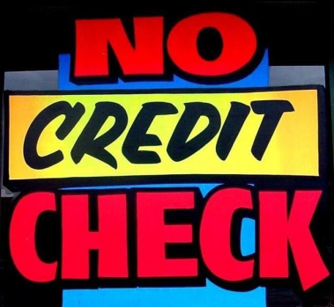

Predatory Businesses

Slide 56

Strategies for Making Major Purchases
Know what you want.
Examine buying motives.
Do not buy on impulse.
Do your homework.
Comparison shop.
Check the warranty or guarantee.
Get agreements in writing.
Sleep on it.

Slide 57



Predatory Lending
Payday loans
Auto title loans
Refund-anticipation loans
All of these are subject to the Military Lending Act (2007).

Slide 58
Legal Rights of Consumers
Lemon Laws
Auto Repair Facilities Acts
Usury Laws
Repeated repairs entitle buyers to refund or replacement.
State by state.
Regulate estimates, invoices, and more.
Cap interest rates.

Slide 59

Car-Buying Strategies
59

Slide 60




Agenda
The Three Deals of Car Buying
The Purchase
The Financing
The Trade-In
Summary and Sources of Help
60

Slide 61




Deal # 1:
The Purchase
How much can you afford to spend?
What type of car do you want?
Where will you buy your car?
What is a fair price for your car?
61

Slide 62

Review Your Finances
Review your spending plan.
Review your credit report.
Get a preapproved loan.
Determine car payments.
Estimate operating expenses.
Explore “true cost to own” at https://www.edmunds.com/tco.html

Slide 63

Deal # 2:
The Financing
Where will you finance?
What are the finance charges?
Where can you get help with
a contract?
63
63

Slide 64

Deal # 3:
The Trade-in
Private sale: More money,
more effort.
Trade-in: Less money, more convenience.
Use available resources to set
the price.
64
64

Slide 65
Summary and Sources of Help
Airman and Family Readiness Center (A&FRC)
Base legal office
Library/media/online
Handouts

Slide 66

Home-Buying Strategies

Slide 67
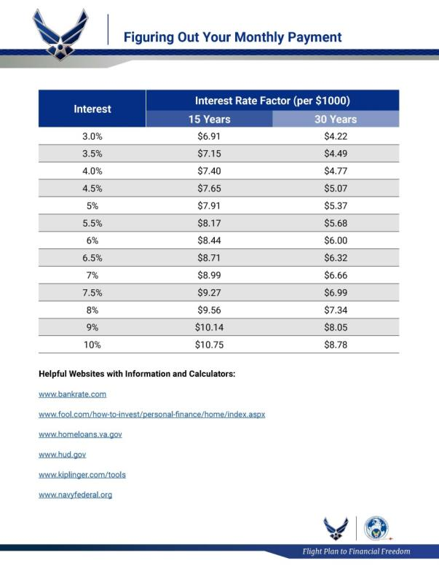
How Much House Can You Afford?
Add escrows (taxes, insurance).
Consider repairs, maintenance, and homeowners association (HOA) dues.

Slide 68



What Kind of House Do You Want?

Slide 69

Down Payments and Closing Costs
Conventional mortgage: 20%.
Federal Housing Administration (FHA): 3%–5%.
Department of Veterans Affairs (VA): Down payment not required.
The more you put down, the lower the total cost of the mortgage.

Slide 70

Choosing a Mortgage Loan
Fixed rate (15 or 30 years)
Adjustable rate
Interest only
Subprime
If possible, get preapproved, not just prequalified for your loan.

Slide 71

The Purpose of Insurance
Transfer risk of financial loss or hardship.
Life events affect
insurance needs.
Air Force provides some insurance, but not all.

Slide 72


Life Insurance
Temporary (Term)
Insurance
Permanent Insurance
(Insurance plus savings)
SGLI
TSGLI/SGLI Disability
FSGLI
VGLI
Commercial policies
Whole life
Universal life
Variable life

Slide 73

Health Insurance
Register family members in Defense Enrollment Eligibility Reporting System (DEERS).
Coordinate any spouse benefits.

Slide 74

Renters and Homeowners Insurance

Slide 75

Auto Insurance
Liability
Property
Medical
Other
Optional

Slide 76
Subtotal: Insurance Review
Use an insurance calculator.
Comparison shop.
Choose high deductibles.
Organize your records.

Slide 77
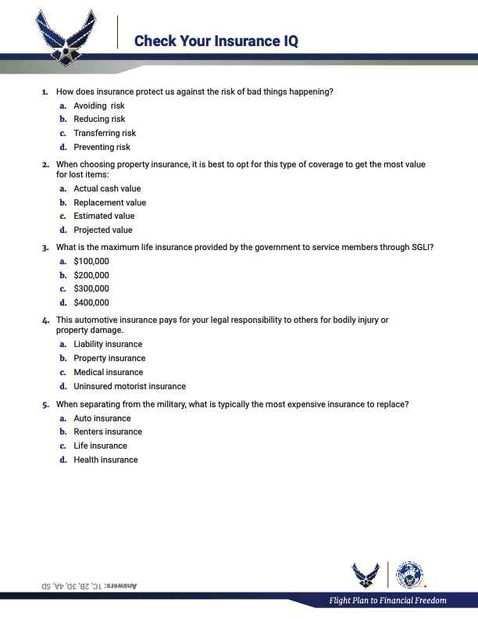
Check Your Insurance IQ

Slide 78
Check Your Insurance IQ
How does insurance protect us against the risk of bad things happening?
a. Avoiding risk
b. Reducing risk
c. Transferring risk
d. Preventing risk

Slide 79
Check Your Insurance IQ
When choosing property insurance, it is best to opt for this type of coverage to get the most value for lost items:
a. Actual cash value
b. Replacement value
c. Estimated value
d. Projected value

Slide 80
Check Your Insurance IQ
What is the maximum life insurance provided by the government to service members through SGLI?
a. $100,000
b. $200,000
c. $300,000
d. $400,000

Slide 81
Check Your Insurance IQ
This automotive insurance pays for your legal responsibility to others for bodily injury or property damage.
a. Liability insurance
b. Property insurance
c. Medical insurance
d. Uninsured motorist insurance

Slide 82
Check Your Insurance IQ
When separating from the military, what is typically
the most expensive insurance to replace?
a. Auto insurance
b. Renters insurance
c. Life insurance
d. Health insurance

Slide 83

CONCLUSION

Slide 84

Conclusion
Evaluations and Certificates
Thank you!

